Slide 1
Fourier’s Law and the
Heat Equation
Chapter Two

Slide 2
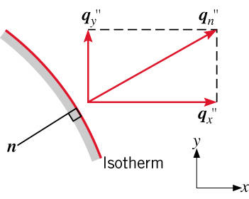
Fourier’s Law
Fourier’s Law
A rate equation that allows determination of the conduction heat flux
from knowledge of the temperature distribution in a medium
Its most general (vector) form for multidimensional conduction is:
Implications:
  Heat transfer is in the direction of decreasing temperature
  (basis for minus sign).
  Fourier’s Law serves to define the thermal conductivity of the
  medium
  Direction of heat transfer is perpendicular to lines of constant
temperature (isotherms).
  Heat flux vector may be resolved into orthogonal components.

Slide 3
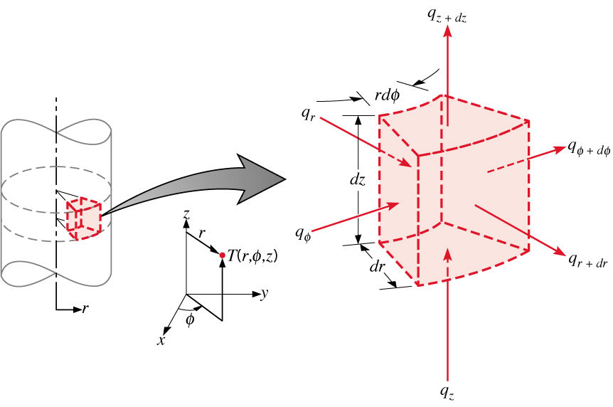
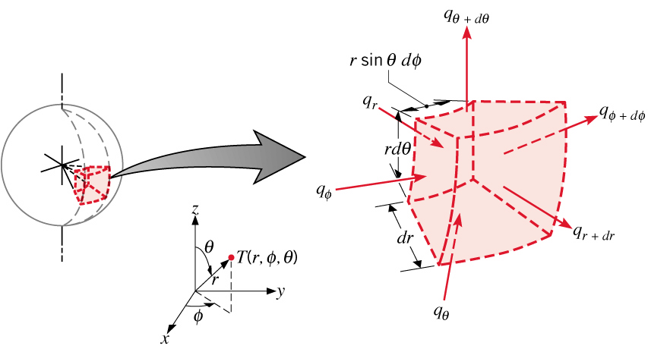
Heat Flux Components
Cartesian Coordinates:
(2.3)
Cylindrical Coordinates:
(2.18)
Spherical Coordinates:
(2.21)

Slide 4
Heat Flux Components (cont.)
In angular coordinates , the temperature gradient is still
based on temperature change over a length scale and hence has
units of °C/m and not °C/deg.
Heat rate for one-dimensional, radial conduction in a cylinder or sphere:
Cylinder
or,
Sphere

Slide 5
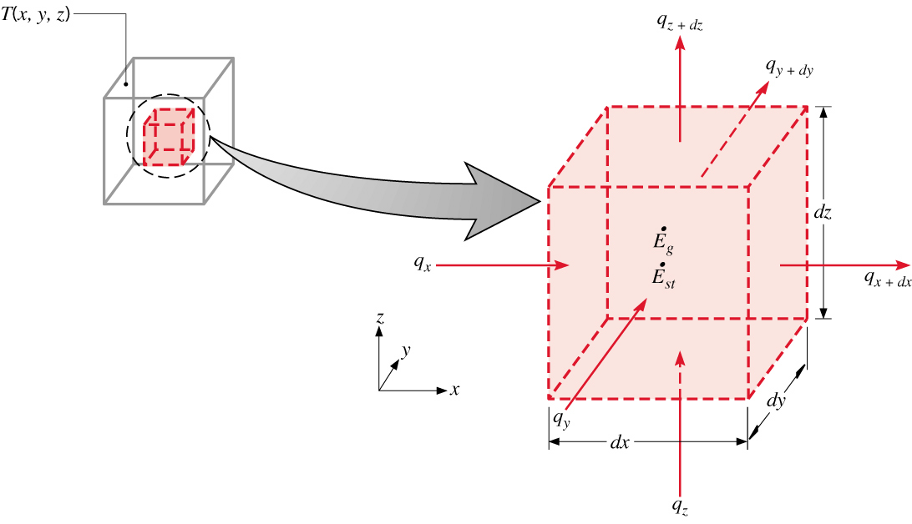
Heat Equation
The Heat Equation
A differential equation whose solution provides the temperature distribution in a
stationary medium.
Based on applying conservation of energy to a differential control volume
through which energy transfer is exclusively by conduction.
Cartesian Coordinates:
(2.13)
Net transfer of thermal energy into the
control volume (inflow-outflow)
Thermal energy
generation
Change in thermal
energy storage

Slide 6
Heat Equation (Radial Systems)
Cylindrical Coordinates:
(2.20)
Spherical Coordinates:
(2.33)

Slide 7

Heat Equation (Special Case)
One-Dimensional Conduction in a Planar Medium with Constant Properties
and No Generation

Slide 8
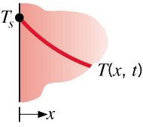
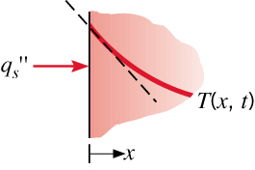
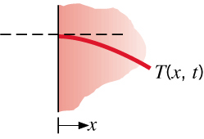
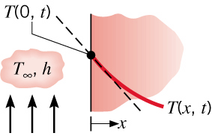
Boundary Conditions
Boundary and Initial Conditions
For transient conduction, heat equation is first order in time, requiring
specification of an initial temperature distribution:
Since heat equation is second order in space, two boundary conditions
must be specified. Some common cases:
Constant Surface Temperature:
Constant Heat Flux:
Applied Flux
Insulated Surface
Convection

Slide 9
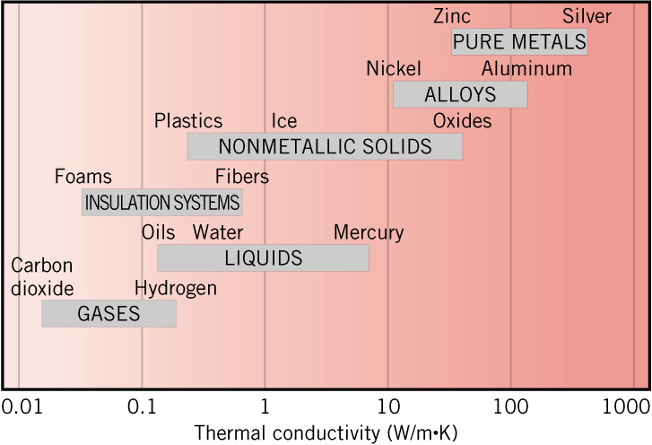
Properties
Thermophysical Properties
Thermal Conductivity: A measure of a material’s ability to transfer thermal
energy by conduction.
Thermal Diffusivity: A measure of a material’s ability to respond to changes
in its thermal environment.
Property Tables:
Solids: Tables A.1 – A.3
Gases: Table A.4
Liquids: Tables A.5 – A.7

Slide 10
Conduction Analysis
Methodology of a Conduction Analysis
Solve appropriate form of heat equation to obtain the temperature
distribution.
Knowing the temperature distribution, apply Fourier’s Law to obtain the
heat flux at any time, location and direction of interest.
Applications:
  Chapter 3: One-Dimensional, Steady-State Conduction
  Chapter 4: Two-Dimensional, Steady-State Conduction
  Chapter 5: Transient Conduction

Slide 11
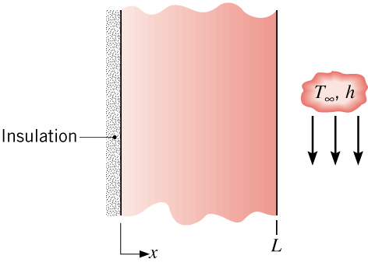
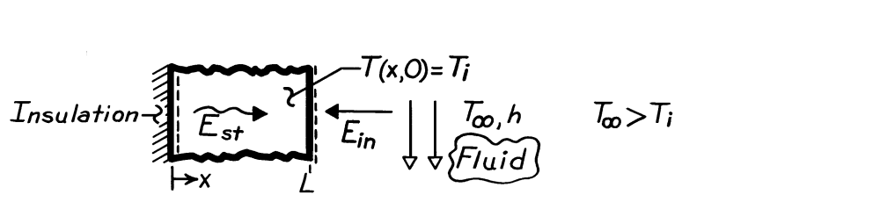
Problem: Thermal Response of Plane Wall
Problem 2.46 Thermal response of a plane wall to convection heat transfer.

Slide 12
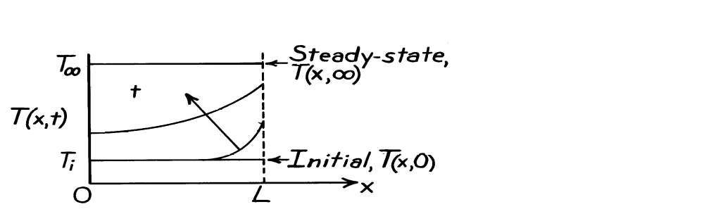
Problem: Thermal Response (Cont).

Slide 13
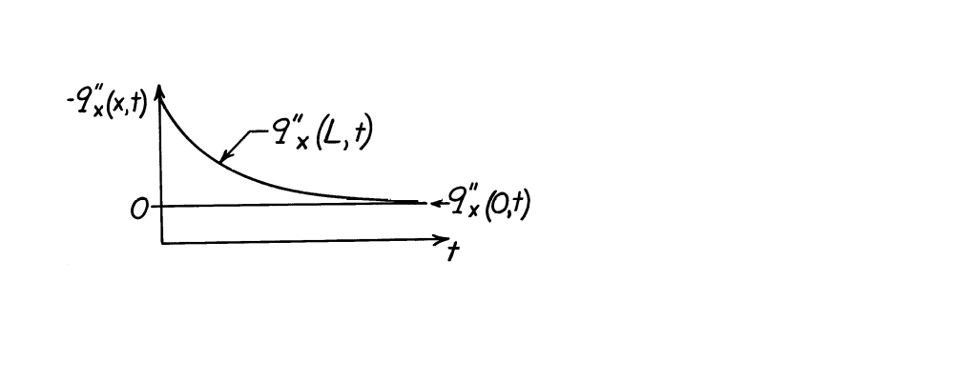
Problem: Thermal Response (Cont).
d) The total energy transferred to the wall may be expressed as
Dividing both sides by A_{s}L, the energy transferred per unit volume is

Slide 14
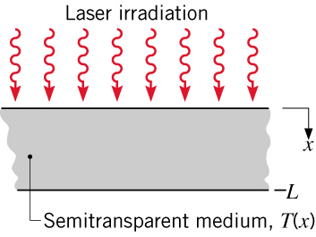
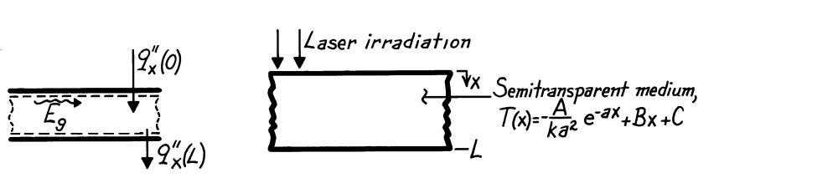
Problem: Non-uniform Generation due to Radiation Absorption
Problem 2.28 Surface heat fluxes, heat generation and total rate of radiation
absorption in an irradiated semi-transparent material with a
prescribed temperature distribution.

Slide 15
Problem : Non-uniform Generation (Cont.)

Slide 16
Problem : Non-uniform Generation (Cont.)

